Slide 1
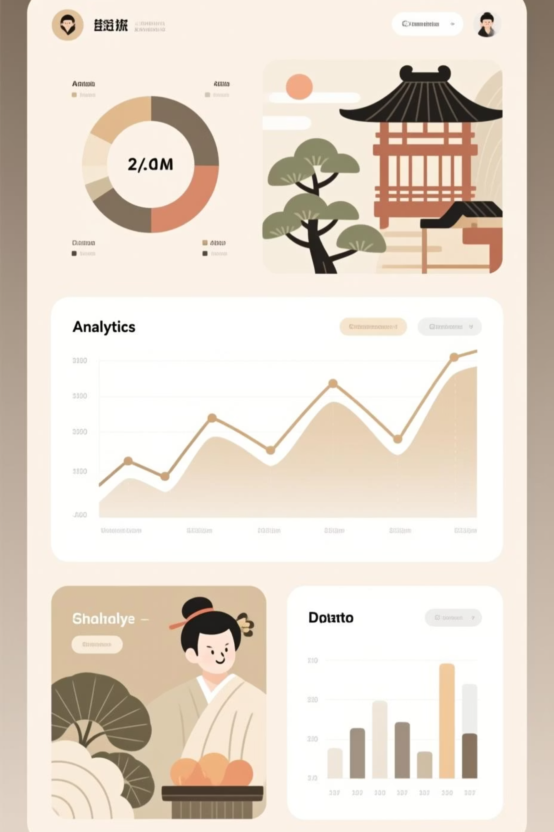
Customer Shopping Behavior Analysis
Uncovering insights from 3,900 purchases to drive strategic business decisions

Slide 2
Dataset at a Glance
3,900
18
37
Total Purchases
Data Points
Missing Values
Transactional records analyzed
Features per transaction
In Review Rating column only
Customer Demographics
Shopping Behavior
Age, Gender, Location
Purchase patterns & frequency
Subscription Status
Discounts, ratings, shipping

Slide 3

Data Preparation Journey
01
Data Loading & Exploration
Imported dataset using pandas, analyzed structure with df.info() and summary statistics
02
Missing Data Handling
Imputed Review Rating nulls using median rating per product category
03
Feature Engineering
Created age_group bins and purchase_frequency_days columns for deeper insights
04
Database Integration
Connected to PostgreSQL and loaded cleaned data for SQL analysis

Slide 4
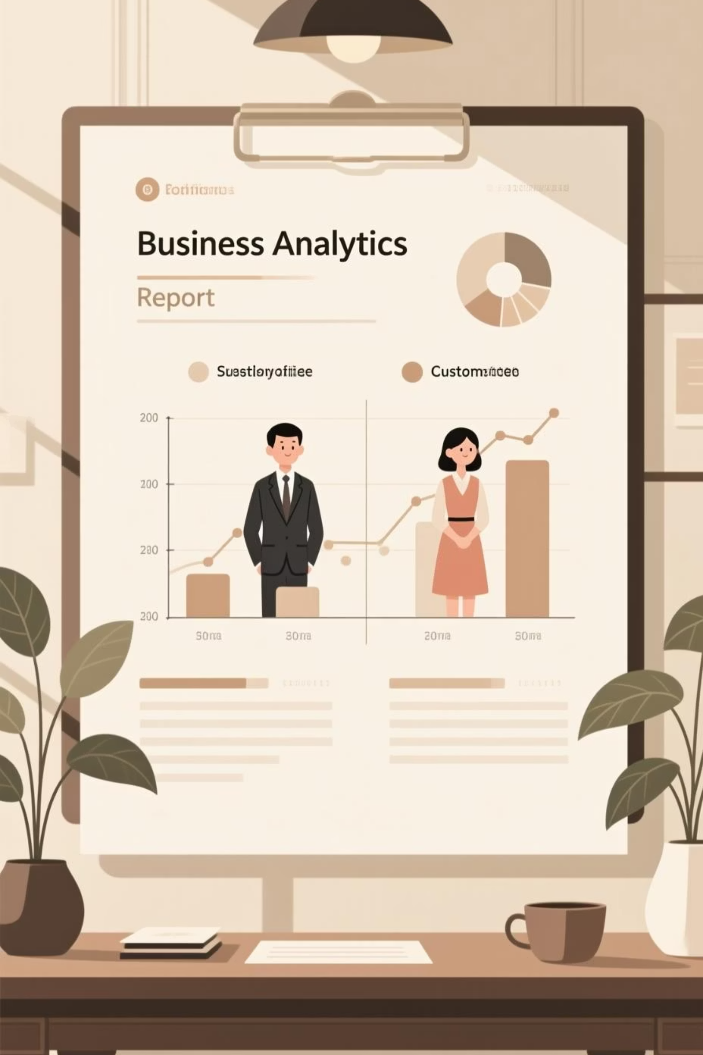
Revenue Insights by Gender
Analyzed total revenue generated by male vs. female customers to identify spending patterns and opportunities for targeted marketing strategies.
Understanding gender-based spending helps optimize product positioning and promotional campaigns

Slide 5
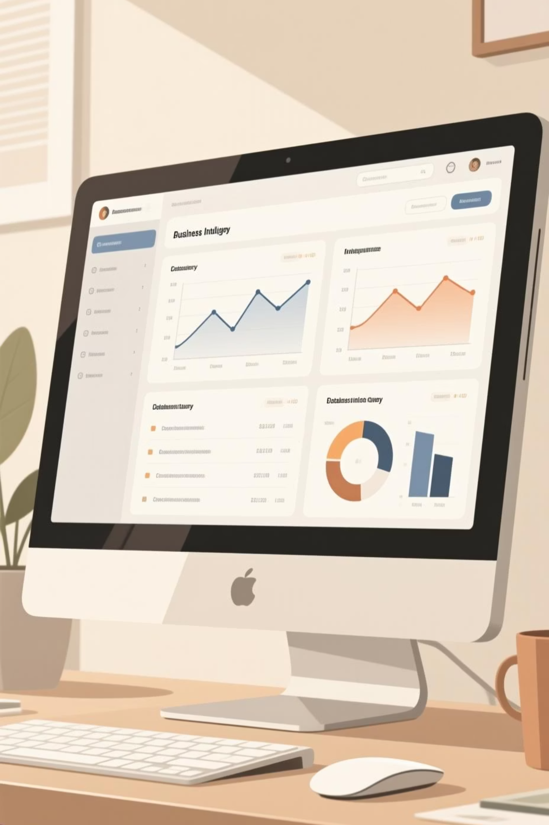

Key SQL Analysis Findings
High-Spending Discount Users
Top 5 Products by Rating
Found highest-rated products for promotional focus
Identified customers using discounts while spending above average
Shipping Type Comparison
Compared Standard vs. Express shipping purchase amounts

Slide 6


Subscribers Drive Higher Value
68%
42%
Higher Average Spend
Revenue Contribution
Subscribers spend more per transaction than non-subscribers
Subscribers generate disproportionate share of total revenue
Subscription status strongly correlates with customer lifetime value and purchase frequency

Slide 7



Customer Segmentation Strategy
Loyal
Frequent buyers, highest value
Returning
Multiple purchases, growing engagement
New
First-time customers, conversion focus
Discount-Dependent Products
Repeat Buyer Patterns
5 products with highest percentage of discounted purchases identified for margin optimization
Customers with 5+ purchases show significantly higher subscription rates

Slide 8

Revenue by Age Group
Young Adults (18-30)
Middle Age (31-50)
High frequency, moderate spend per transaction
Highest revenue contribution, premium product preference
Mature (51+)
Loyal customers, consistent purchasing patterns

Slide 9

Interactive Power BI Dashboard
Visual Insights
Interactive Features
Real-time revenue tracking
Filter by demographics
Customer segment analysis
Drill-down capabilities
Product performance metrics
Trend visualization

Slide 10





Strategic Recommendations
Boost Subscriptions
Promote exclusive benefits to convert high-frequency buyers
Customer Loyalty Programs
Reward repeat buyers to move them into "Loyal" segment
Review Discount Policy
Balance sales boosts with margin control on discount-dependent products
Targeted Marketing
Focus on high-revenue age groups and express-shipping users

